Slide 1
HTML - Events

Slide 2
Windows Event addEventListener
The entire browser window to accept a key press event:
window.addEventListener( "keypress", doKeyDown, false )
So the first arguments tells addEventListener that we want to activate the keypress event. The second argument is a function we've called doKeyDown. This is the function that will be called whenever a key is pressed on the keyboard.

Slide 3
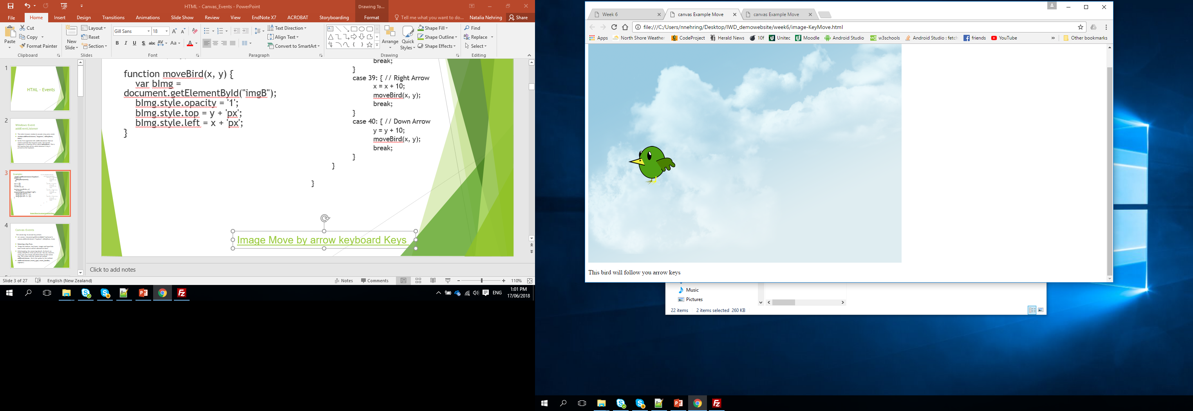
Example:
function doKeyDown(event){
switch(event.keyCode) {
case 37: { // Left Arrow
x = x - 10;
moveBird(x, y);
break;
}
case 38: { // Up Arrow
y = y - 10;
moveBird(x, y);
break;
}
case 39: { // Right Arrow x = x + 10;
moveBird(x, y);
break;
}
case 40: { // Down Arrow
y = y + 10;
moveBird(x, y);
break;
}
}
}
window.addEventListener("keydown", event => {
doKeyDown(event);
});
var x = 50;
var y = 50;
moveBird(x, y);
function moveBird(x, y) {
var bImg = document.getElementById("imgB");
bImg.style.opacity = '1';
bImg.style.top = y + 'px';
bImg.style.left = x + 'px';
}
Image Move by arrow keyboard Keys

Slide 4
Canvas-Events
The canvas tag -to accept key presses:
var canvas = document.getElementById(“myCanvas"); canvas.addEventListener( "keydown", doKeyDown, true);
Detecting a Key Press
Things like buttons, text boxes, images and hyperlinks have events such as onClick attached to them.
Unfortunately, the canvas tag doesn't. So there's no handy onKeyPress event you can use. You can, however, write your own events and attach them to the canvas tag. This is done with the Javascript method addEventListener. Here's the syntax for the method:
addEventListener( event_type, event_handler, capture )

Slide 5
document.addEventListener(event, function, useCapture)
Parameter | Description
event | Required. A String that specifies the name of the event. Note: Do not use the "on" prefix. For example, use "click" instead of "onclick". For a list of all HTML DOM events, look at our complete HTML DOM Event Object Reference.
function | Required. Specifies the function to run when the event occurs. When the event occurs, an event object is passed to the function as the first parameter. The type of the event object depends on the specified event. For example, the "click" event belongs to the MouseEvent object.
useCapture | Optional. A Boolean value that specifies whether the event should be executed in the capturing or in the bubbling phase. Possible values:true - The event handler is executed in the capturing phase false- Default. The event handler is executed in the bubbling phase

Slide 6
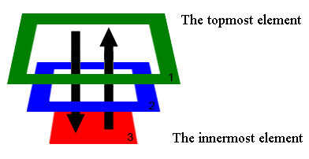
Capturing
In all browsers, except IE<9, there are two stages of event processing.
The event first goes down - that’s called capturing, and then bubbles up. This behavior is standartized in W3C specification.
According to this model, the event:
Captures down - through 1 -> 2 -> 3.
Bubbles up - through 3 -> 2 -> 1.
elem.addEventListener( type,handler, phase )
phase = true
The handler is set on the capturing phase.
phase = false
The handler is set on the bubbling phase.

Slide 7
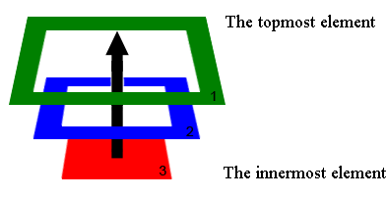
Bubbling
The main principle of bubbling states: After an event triggers on the deepest possible element, it then triggers on parents in nesting order.
For example, http://javascript.info/tutorial/bubbling-and-capturing
.

Slide 8
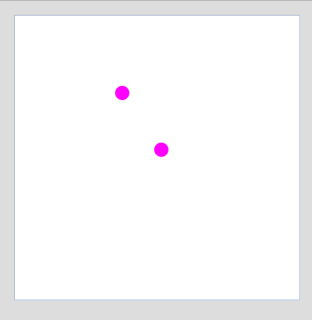
Mouse click canvas
<script>
var context;
var x=10;
var y=10;
function init()
{
context = document.getElementById("myCanvas");
context.addEventListener("mousedown", getPosition, false);
}
function draw(x,y)
{
context = document.getElementById("myCanvas");
context= myCanvas.getContext('2d');
context.beginPath();
context.fillStyle="#FF00FF";
// Draws a circle of radius 10 at the coordinates x,y on the canvas
context.arc(x,y,10,0,2*Math.PI,true);
context.closePath();
context.fill();
}
function getPosition(event)
{
var x = event.x;
var y = event.y;
//alert("x:" + x + " y:" + y);
draw(x,y);
}
</script>

Slide 9
canvas.addEventListener ( "keydown", doKeyDown, true);
“keydown” event
doKeyDown – function
True – indicate capturing
Every time we “move” our object – we actually re-draw it in new place

Slide 10
canvas.addEventListener ( "keydown", doKeyDown, true);
function doKeyDown(e){
switch(event.keyCode) {
case 37: { // Left Arrow
updateCanvas();
x = x - 10;
drawRec(x,y);
break;
}
case 38: { // Up Arrow
updateCanvas();
y = y - 10;
drawRec(x,y);
break;
}
case 39: { // Right Arrow
updateCanvas();
x = x + 10;
drawRec(x,y);
break;
}
case 40: { // Down Arrow
updateCanvas();
y = y + 10;
drawRec(x,y);
break;
}
}
}

Slide 11
cxt.fillRect(x, y, 50, 30);
x | The x-coordinate of the upper-left corner of the rectangle
y | The y-coordinate of the upper-left corner of the rectangle
width | The width of the rectangle, in pixels
height | The height of the rectangle, in pixels

Slide 12
function drawRec(x,y) {
cxt.fillStyle="black";
cxt.fillRect(x, y, 50, 30);
}
function updateCanvas() {
cxt.clearRect(0,0,canvas.width,canvas.height);
cxt.fillStyle="#FF00FF";
cxt.fillRect(x1, y1, 30, 30);
cxt.fillRect(x2, y2, 30, 30);
cxt.fillRect(x3, y3, 30, 30);
}

Slide 13
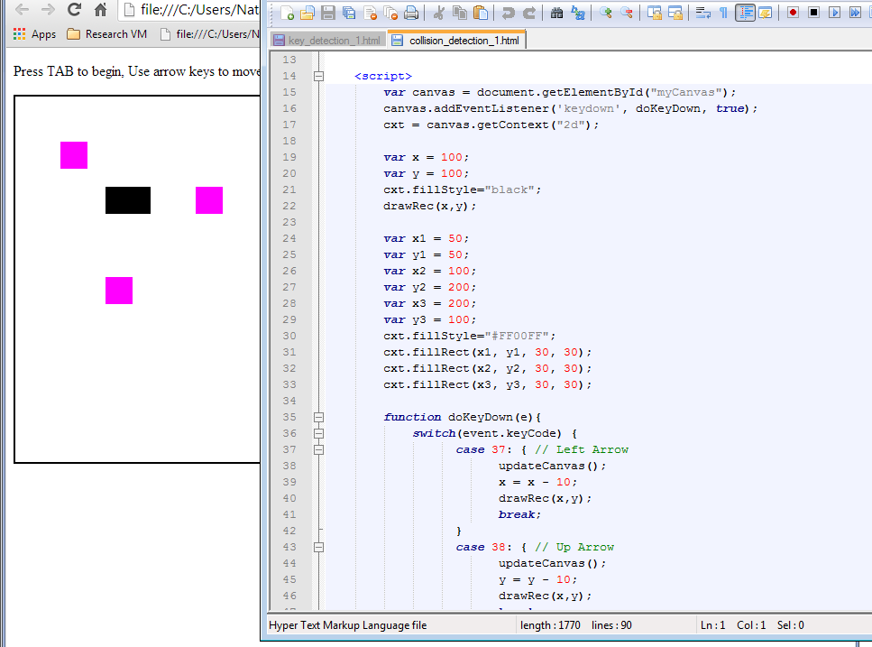
We add 3 static pink rectangular

Slide 14
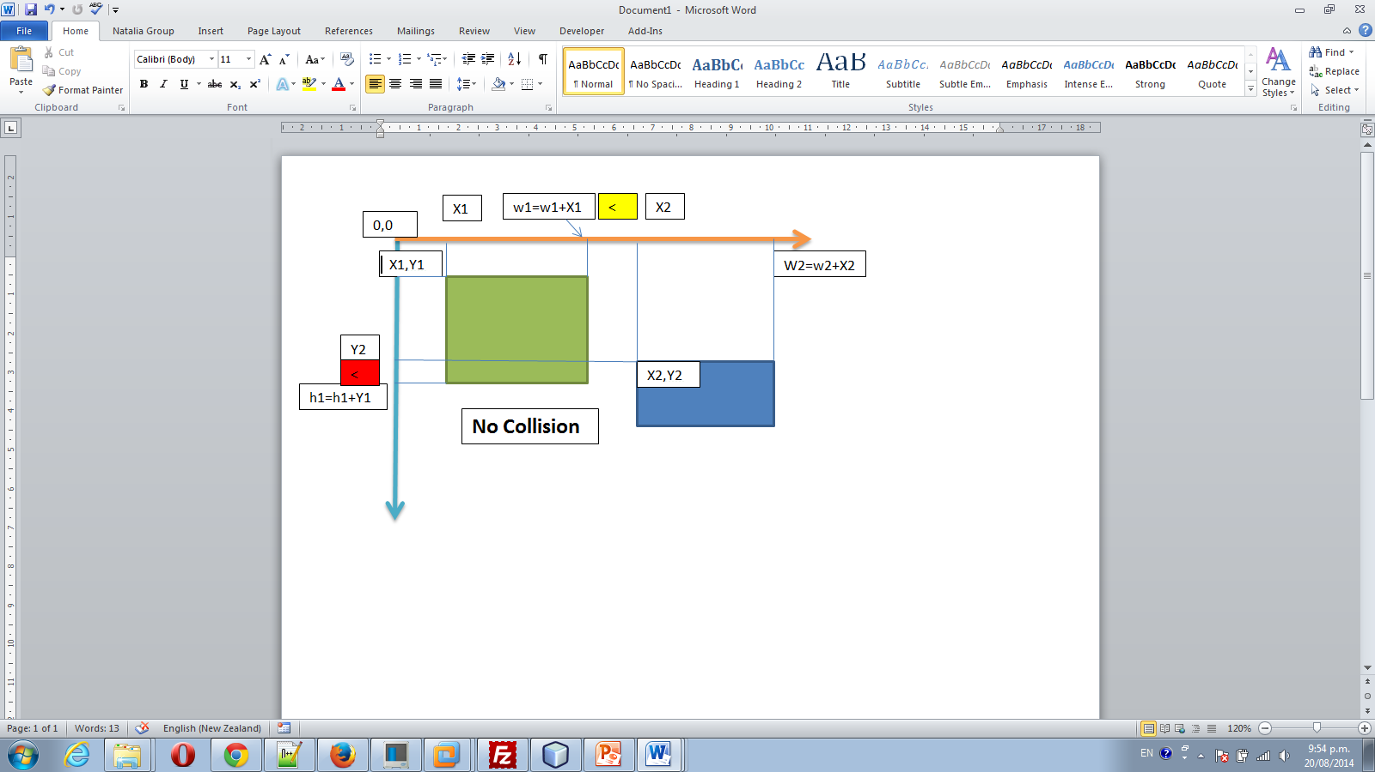
Collision detection:

Slide 15
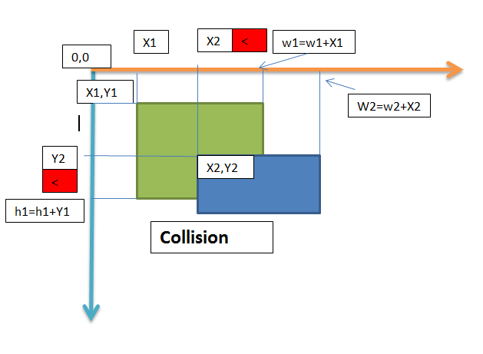
Collision detection:

Slide 16
function intersects(x1, y1, w1, h1, x2, y2, w2, h2) {
w2 += x2;
w1 += x1;
if (x2 > w1 || x1 > w2) return false;
h2 += y2;
h1 += y1;
if (y2 > h1 || y1 > h2) return false;
return true;
}

Slide 17
Array declaration in java-script:
var box1=[x1, y1, 30, 30];
var box2=[x2, y2, 30, 30];
var box3=[x3, y3, 30, 30];
//var boxs = [box1,box2, box3]; // one way
var boxs = []; // better way, more dynamic!
boxs.push(box1);
boxs.push(box2);
boxs.push(box3);

Slide 18
function check(x, y, w, h) {
for (i = 0; i < boxs.length; i++) {
var x1=boxs[i][0];
var y1=boxs[i][1];
var w1=boxs[i][2];
var h1=boxs[i][3];
if (intersects(x, y, w, h, x1, y1, w1, h1))
{
alert (" x=" +x1 +" y=" +y1 +
" w=" +w1 +" h=" + h1);
//playSound('beep-1.mp3');
}
}
}

Slide 19
Add sound to the game
<span id="dummy"></span>
In your java-script add :
function playSound(soundfile)
{
document.getElementById("dummy").innerHTML=
"<embed src=\""+soundfile+"\" hidden=\"true\" autostart=\"true\" loop=\"false\" />";
}
Add function call:
playSound('beep-1.mp3');

Slide 20
Removing element from array
After collision was detected - we want to remove that box:
boxs.splice(i, 1);
The splice() method adds/removes items to/from an array, and returns the removed item(s).
Note: This method changes the original array.

Slide 21
array.splice(index,howmany,item1,.....,itemX)
index | Required. An integer that specifies at what position to add/remove items, Use negative values to specify the position from the end of the array
howmany | Required. The number of items to be removed. If set to 0, no items will be removed
item1, ..., itemX | Optional. The new item(s) to be added to the array
http://www.w3schools.com/jsref/jsref_splice.asp

Slide 22
function updateCanvas() {
cxt.clearRect(0,0, canvas.width,canvas.height);
cxt.fillStyle="#FF00FF";
for (i = 0; i < boxs.length; i++) {
var nx=boxs[i][0];
var ny=boxs[i][1];
var nw=boxs[i][2];
var nh=boxs[i][3];
cxt.fillRect(nx, ny, nw, nh);
}
writeScore(sc);
}

Slide 23
Math.floor(x ) –
Round a number downward to its nearest integer
Math.random() –
Return a random number between 0 (inclusive) and 1 (exclusive).

Slide 24
function updateCanvas() {
cxt.clearRect(0,0, canvas.width,canvas.height); //Clear Canvas
cxt.fillStyle="#FF00FF";
//Check if we should generate a new Rectangle to start move
if (Math.random() < 0.09) {
nx = -10;
ny = Math.floor(Math.random() * canvas.height);
boxs.push([nx, ny, 30, 30]);
}
//Update the position of the rectangles
for (var i=boxs.length - 1; i >= 0; i--) {
boxs[i][0]=boxs[i][0]+5; //update x position
if (boxs[i][0] > canvas.width)
boxs.splice(i, 1);
else {
cxt.fillRect(boxs[i][0], boxs[i][1], boxs[i][2], boxs[i][3]);
}
}
writeScore(sc); //Update Score
}

Slide 25
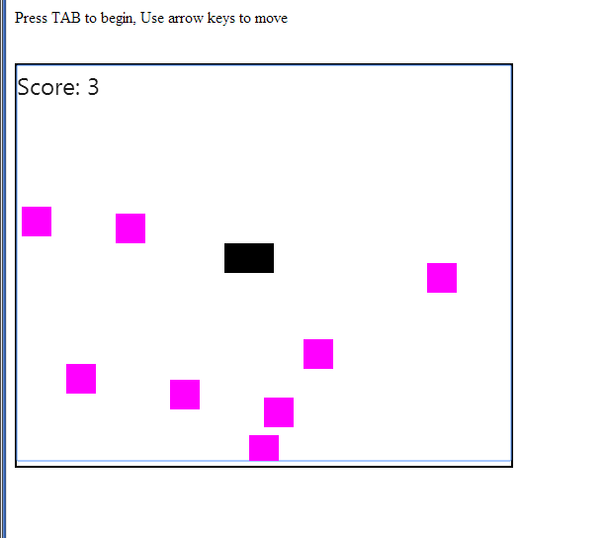
Simple game:
Collision detection
Score
Animation
Sound

Slide 26
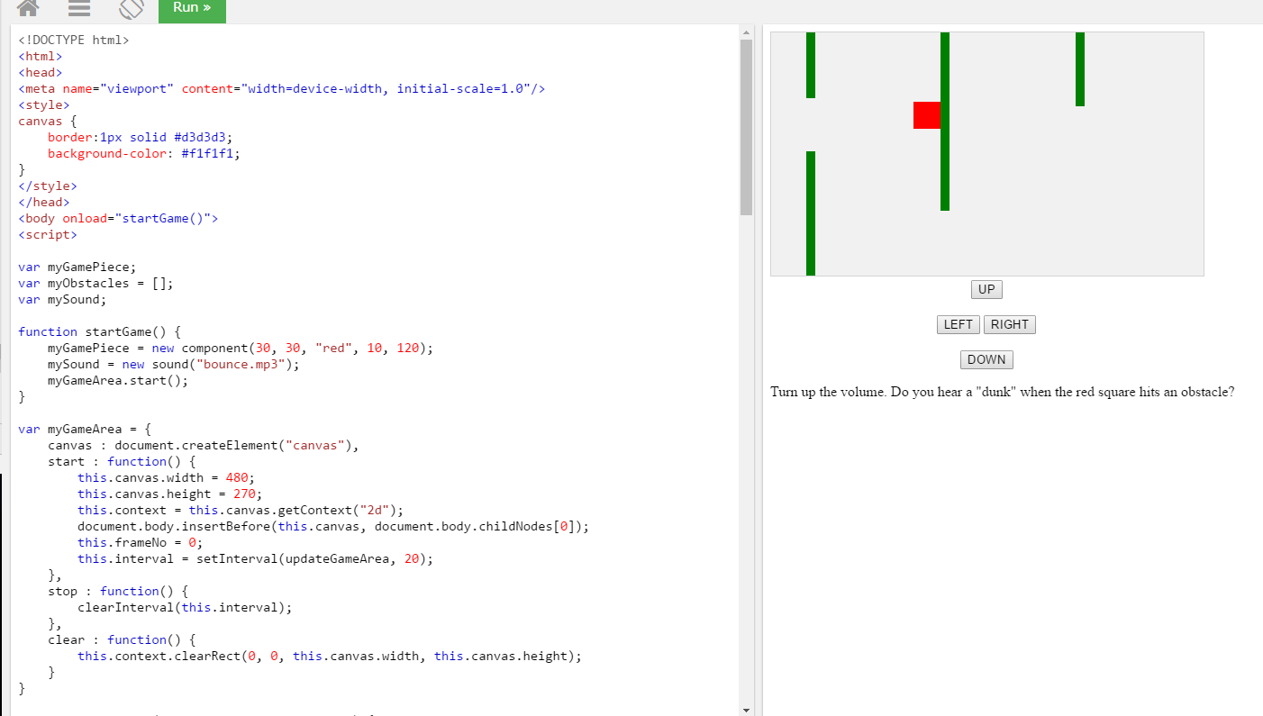
Game Sound
https://www.w3schools.com/graphics/game_sound.asp

Slide 27
Resources:
http://ie.microsoft.com/testdrive/Graphics/CanvasPad/Default.html
http://www.w3schools.com/jsref/jsref_splice.asp
http://www.webbingways.com/bookfiles/chapter3/
http://www.homeandlearn.co.uk/JS/html5_canvas_keyboard_keys.html
http://javascript.info/tutorial/bubbling-and-capturing#capturing
http://www.w3schools.com/js/js_math.asp
https://www.w3schools.com/graphics/game_sound.asp

